Slide 1


OOP
OOP
Object Oriented Programming
OOP
By Mohamed Essam

Slide 2
CONTENTS OF THIS COURSE
Here’s what you’ll find in this :
Introduction to Object Oriented Programming and Design.
Create class Attributes and Methods.
Create Objects and find the Diffrence between Premitive and non-Premetive data types.
Constructor with Parameters and without.
Inhertance.
Class Acess Control.

Slide 3
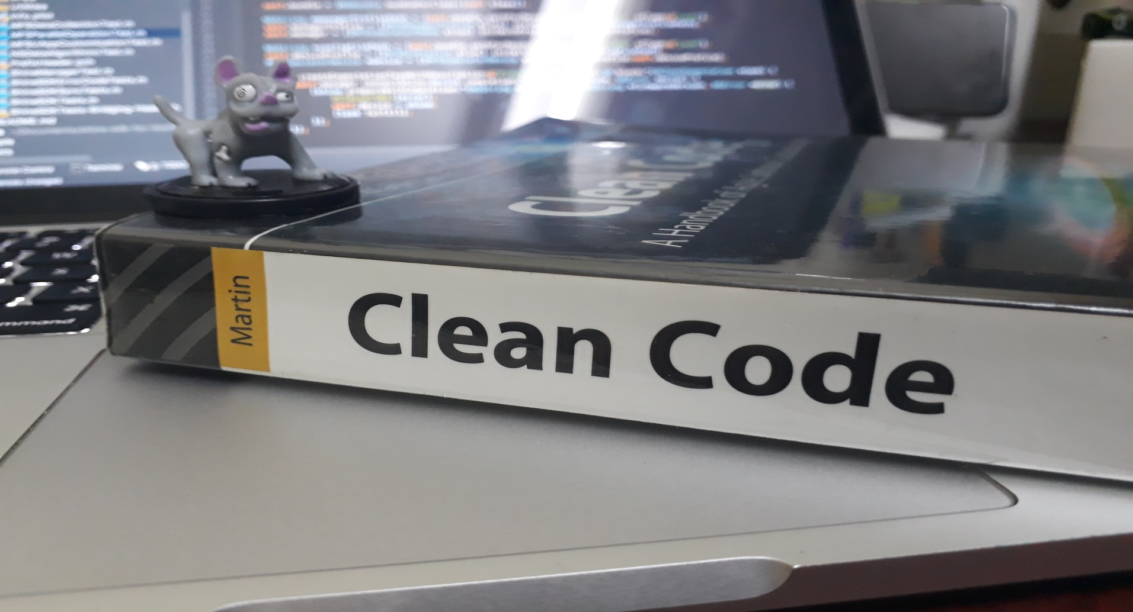
CLEAN CODE

Slide 4

CLEAN CODE

Slide 5

CLEAN CODE

Slide 6
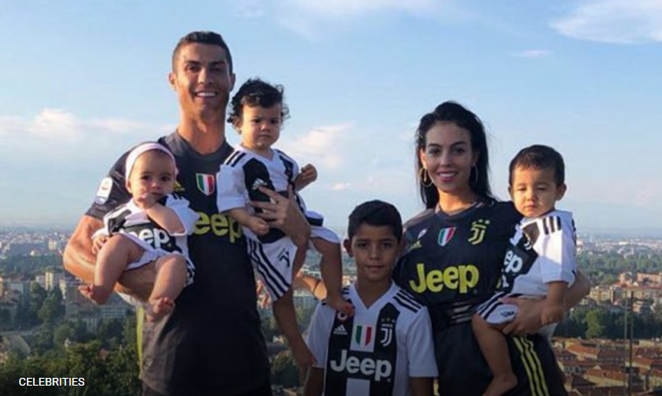
CLEAN CODE
Naming the Variables

Slide 7

CLEAN CODE
Making Functions

Slide 8
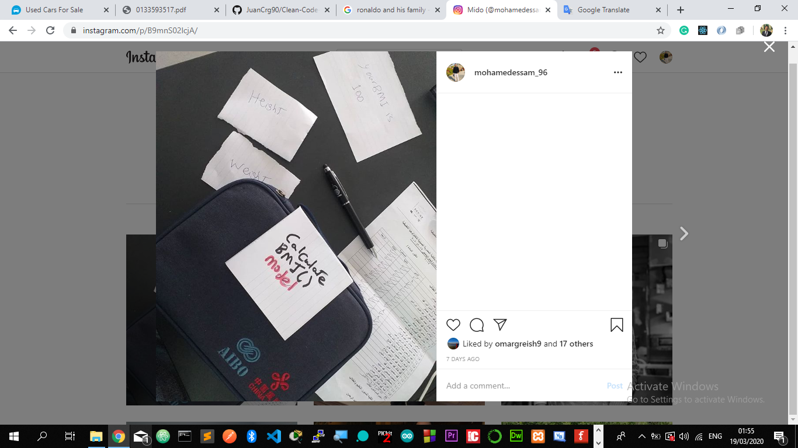
CLEAN CODE

Slide 9
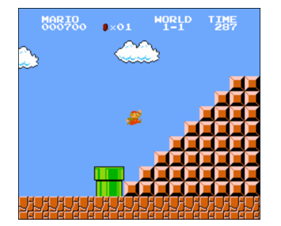
CLEAN CODE

Slide 10
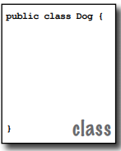

CLEAN CODE
Creating class:
A class is an extensible program-code-template for creating objects, although a very tiny application might need just a single class. The class must go within a pair of curly braces.

Slide 11

CLEAN CODE
Class
Car
Objects
Mercedes
Nissan
Honda
Jeep

Slide 12
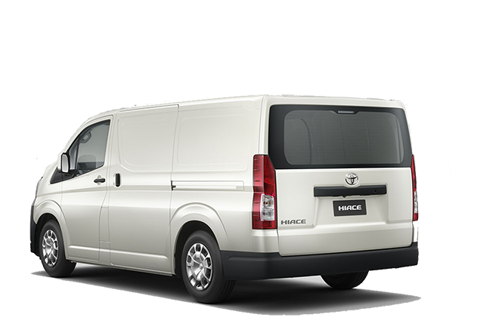

CLEAN CODE
Get speed()
Get space()
Get Age()
Name
Car
Color
Doors
attributes
action

Slide 13

CLEAN CODE
Name
Read()
Sing()
Dance()
Human
Hair look
Skin-color
Body Fat
Attributes
Actions

Slide 14
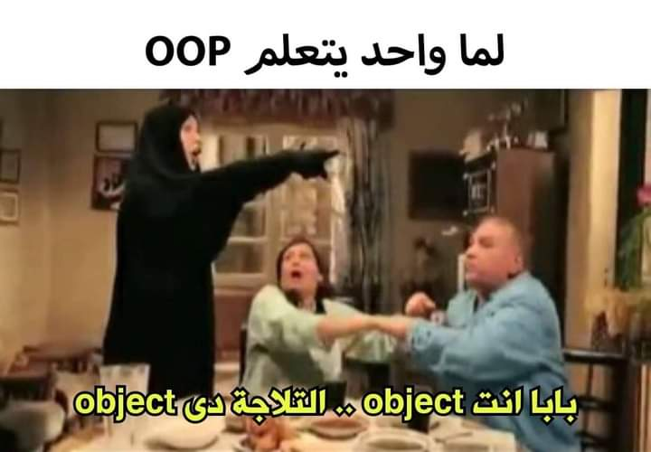
CLEAN CODE

Slide 15


Class design like Blueprint architecture

Slide 16
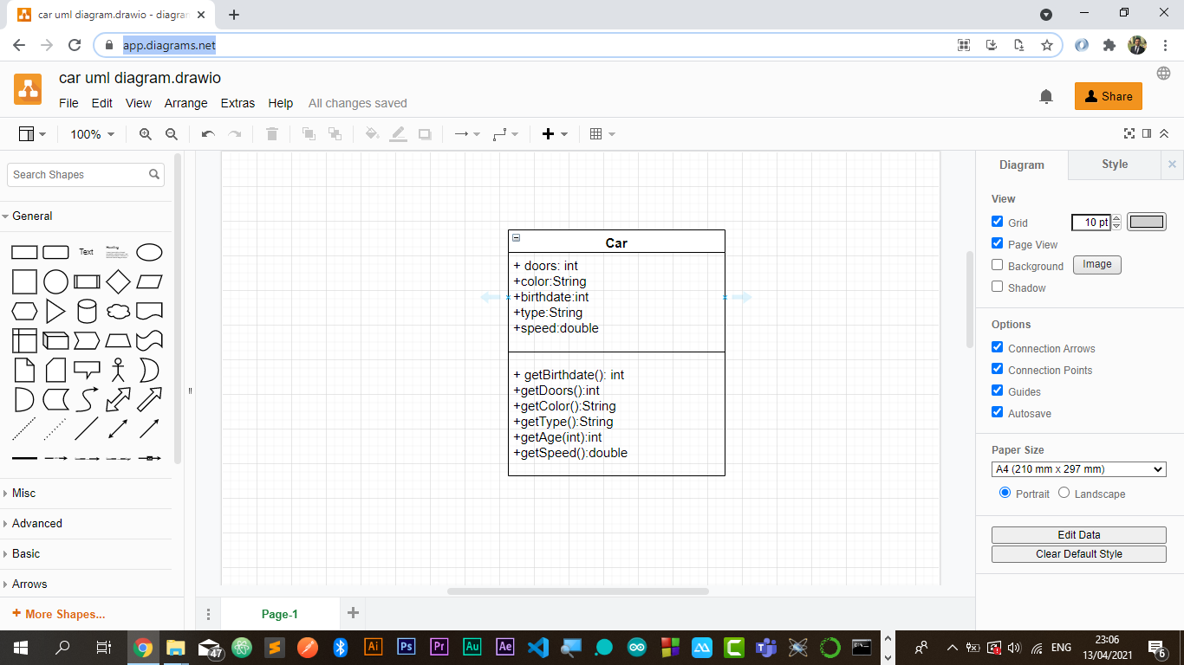
Create Class using unified modeling language UML
By: draw.io

Slide 17



Inheritance

Slide 18
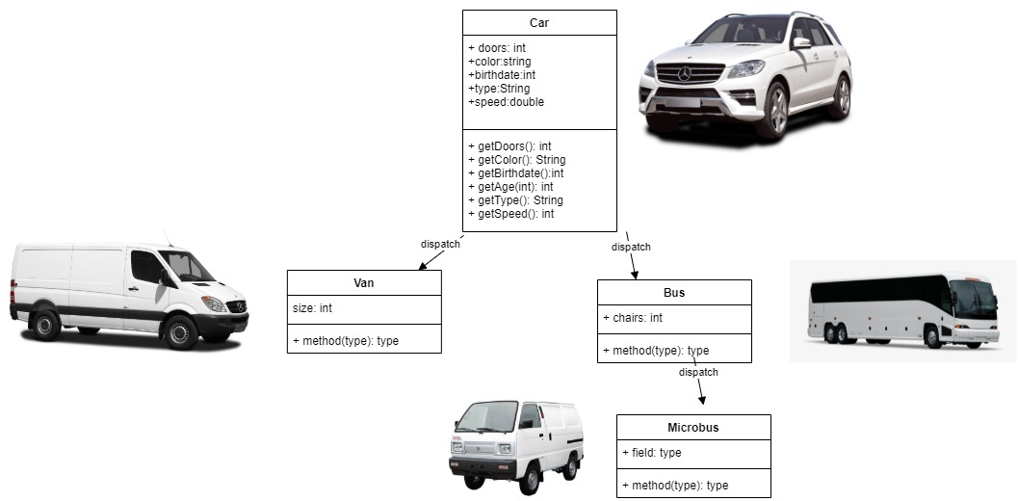
Create Class using unified modeling language UML
By: draw.io

Slide 19

Create Constructor

Slide 20

Class Access Control

